Slide 1




Slide 2

Presented By
•Eslam Ibrahim Badr
•Abdelmonem Ali Elmongy
•Rawan Emad Elghali
•Mennatullah Mohamed Bahaa Eldein
•Yomna Hamed Shehabeldien

Slide 3

Content
01
Introduction
02
ERD & Mapping
Table of Contents
03
DataBase
04
SSRS
05
Powe BI Dashboard
06
Website

Slide 4


Examination System is an educational institution provides :
Dashboards for supervisors and managers to analyze student data, instructor performance, and more.
It provides guidance for professors to evaluate exams and offer valuable feedback.

Slide 5
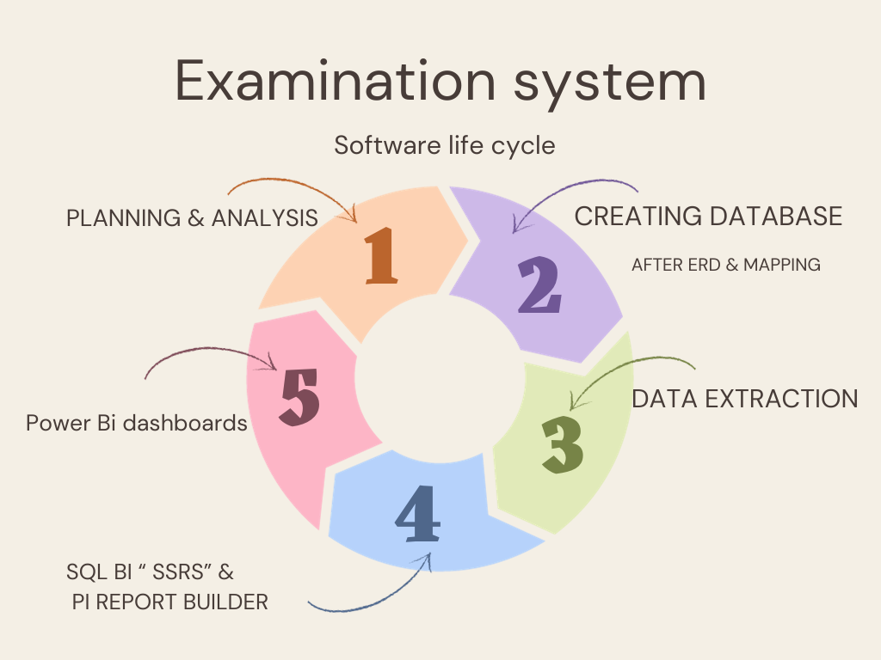
Tools
Microsoft Excel.
SQL BI (SSIS, SSRS)
Microsoft SQL server.
Power bi

Slide 6
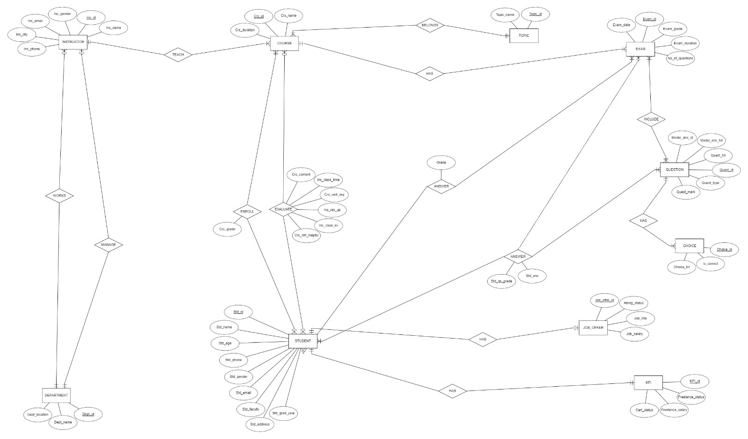
ERD

Slide 7
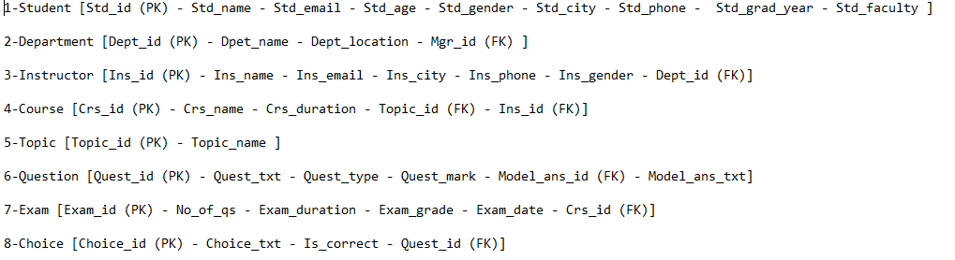
Mapping

Slide 8
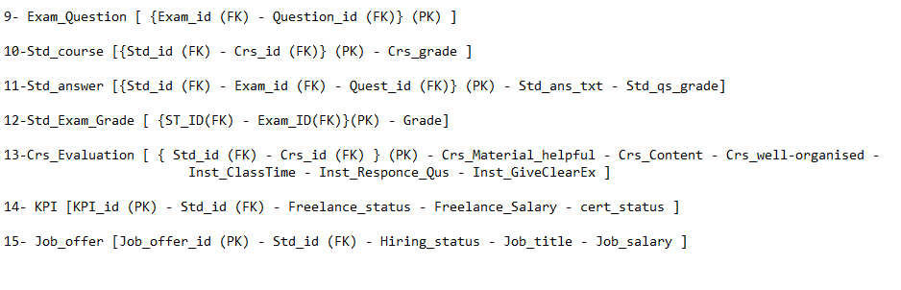
Mapping

Slide 9

Database
Database Creation
Stored procedures
Select ,Insert update and delete in any table
Exam generation
Exam Answers & Correction
Exam Result

Slide 10
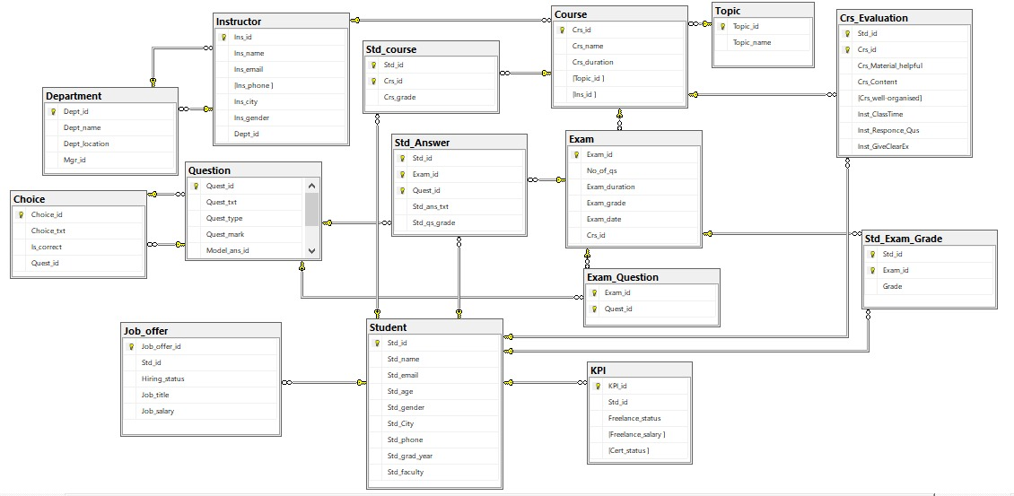
Diagram

Slide 11

Reports

Slide 12
SSRS

Slide 13
SSRS

Slide 14
SSRS

Slide 15
SSRS

Slide 16

Dashboard

Slide 17

Dashboard

Slide 18
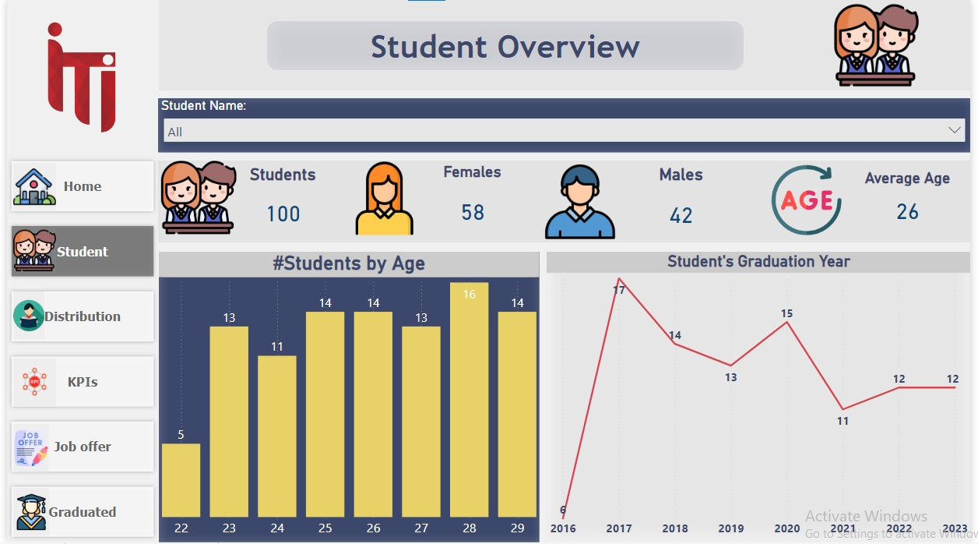
Dashboard

Slide 19
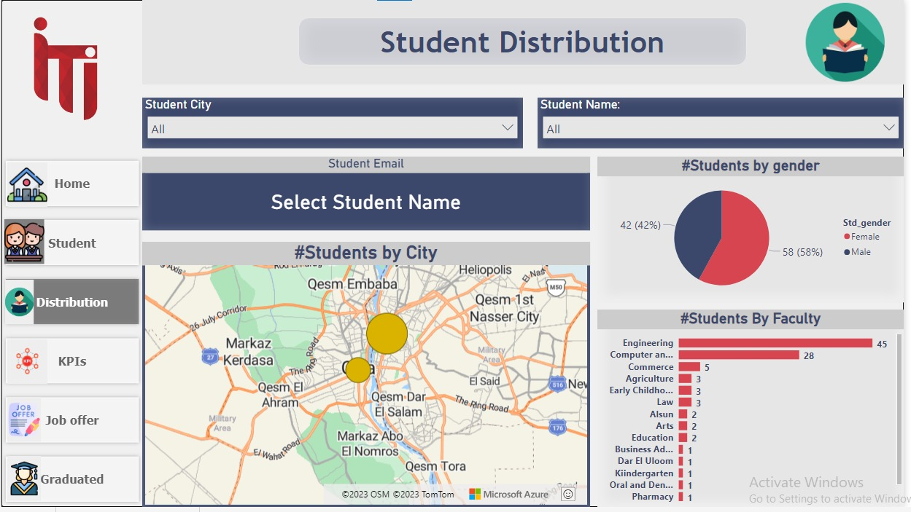
Dashboard

Slide 20
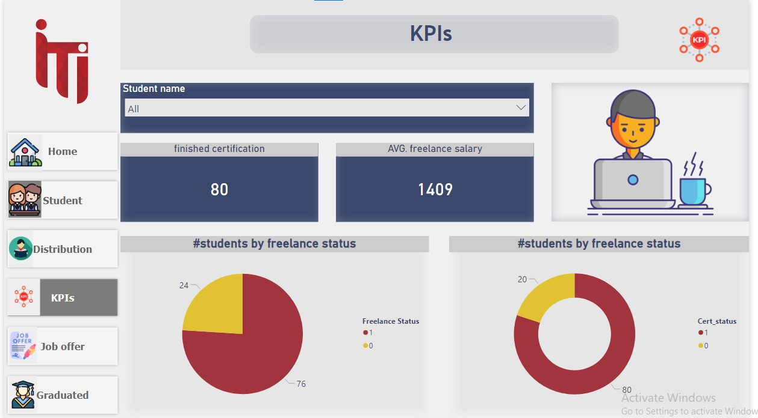
Dashboard

Slide 21
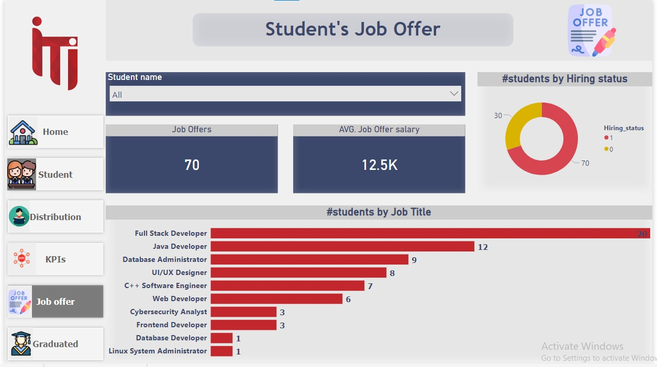
Dashboard

Slide 22
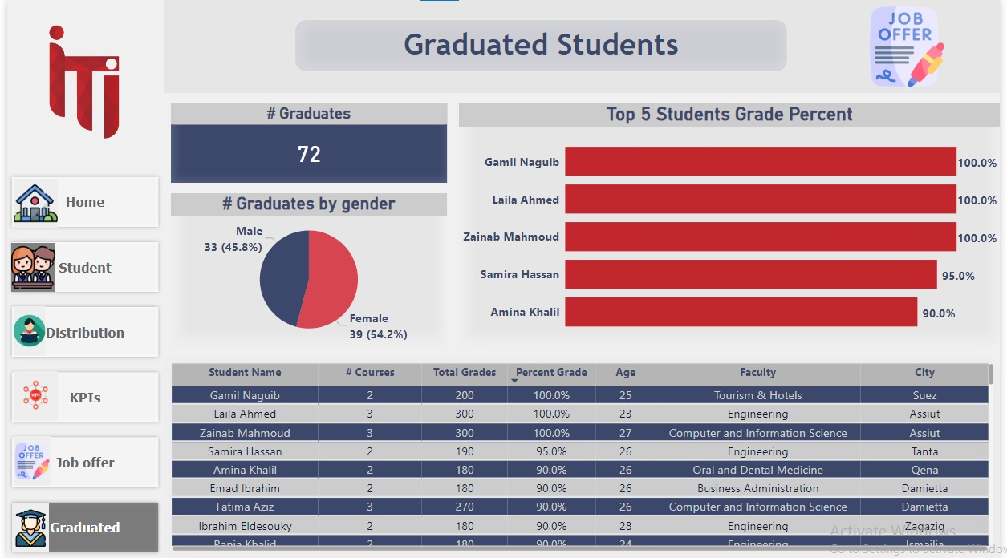
Dashboard

Slide 23
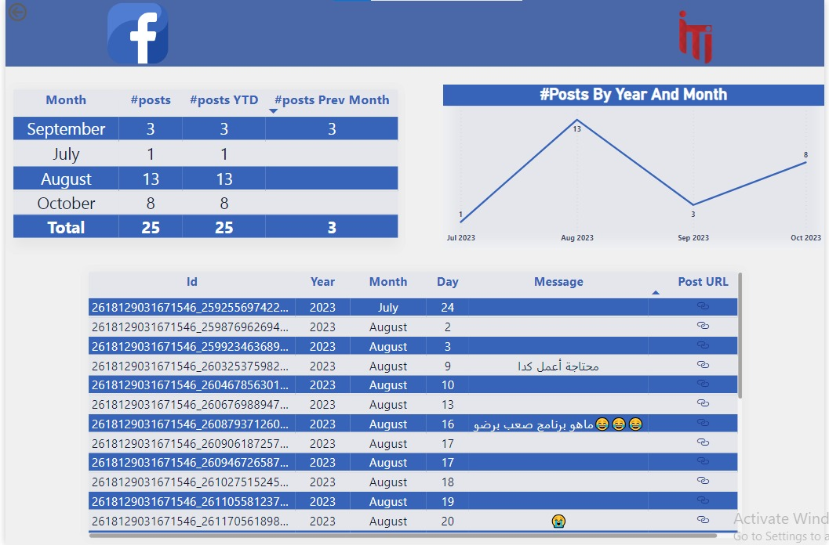
Dashboard

Slide 24
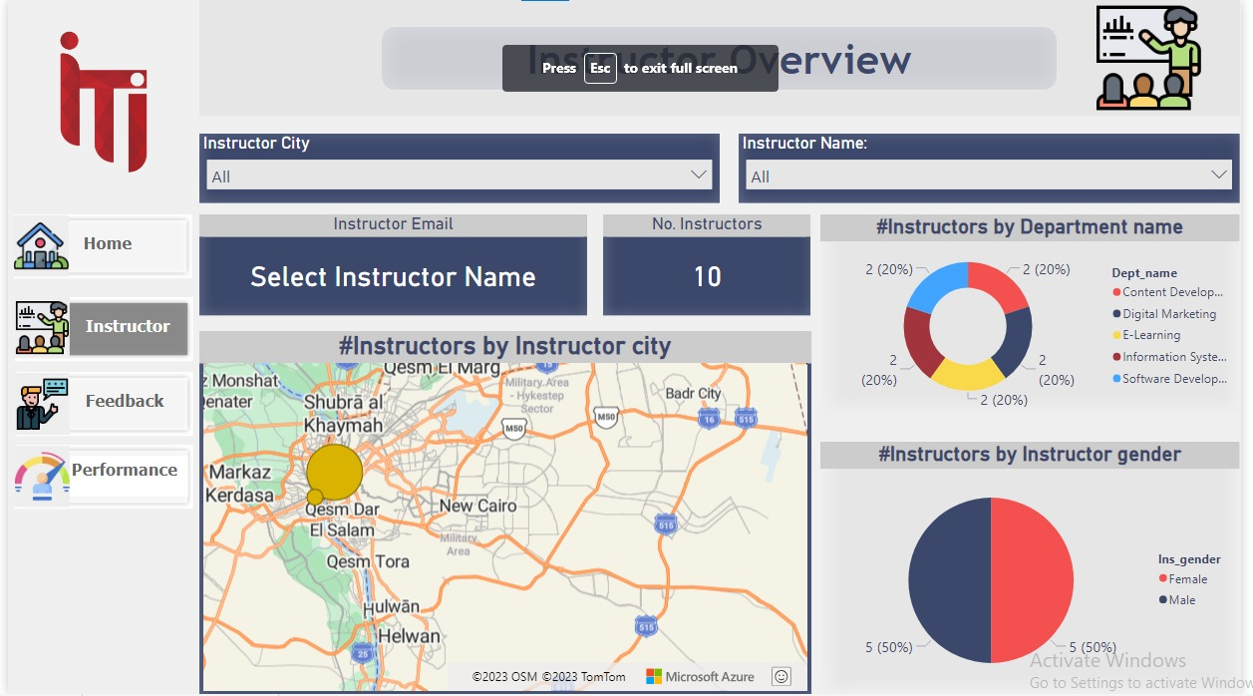
Dashboard

Slide 25
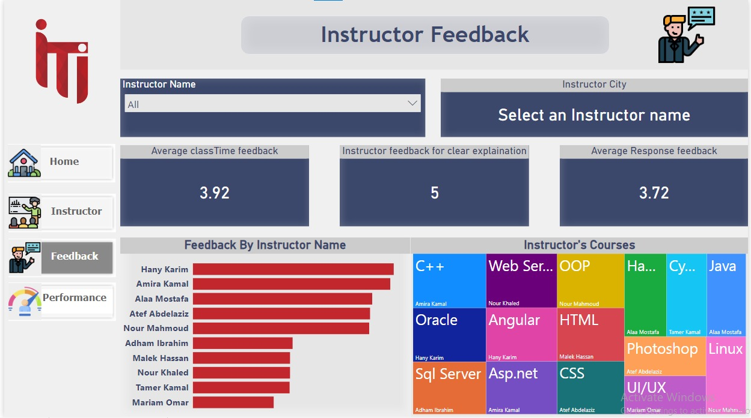
Dashboard

Slide 26
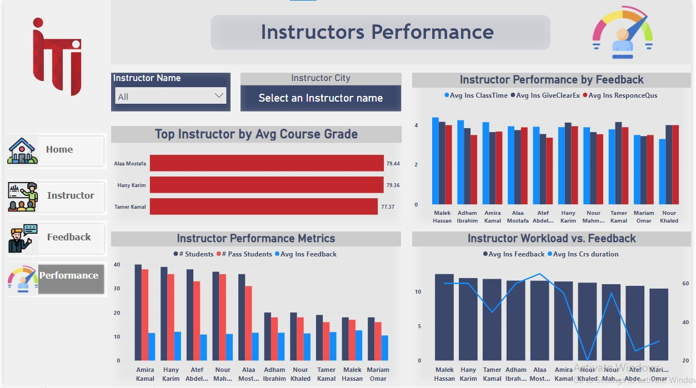
Dashboard

Slide 27
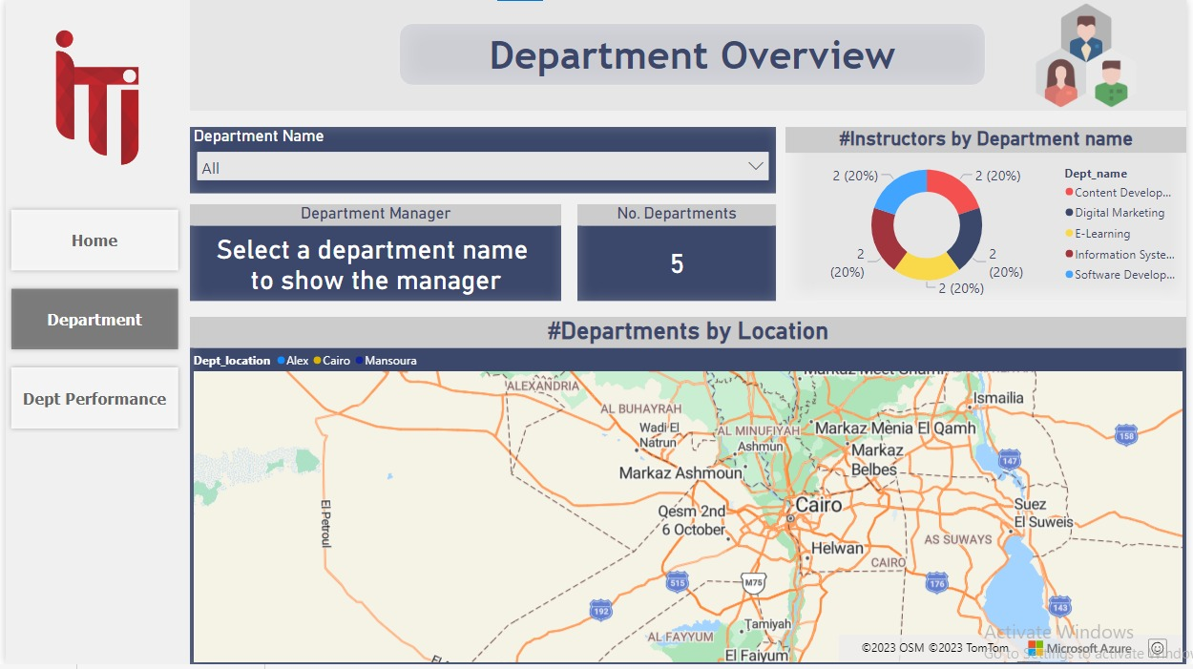
Dashboard

Slide 28
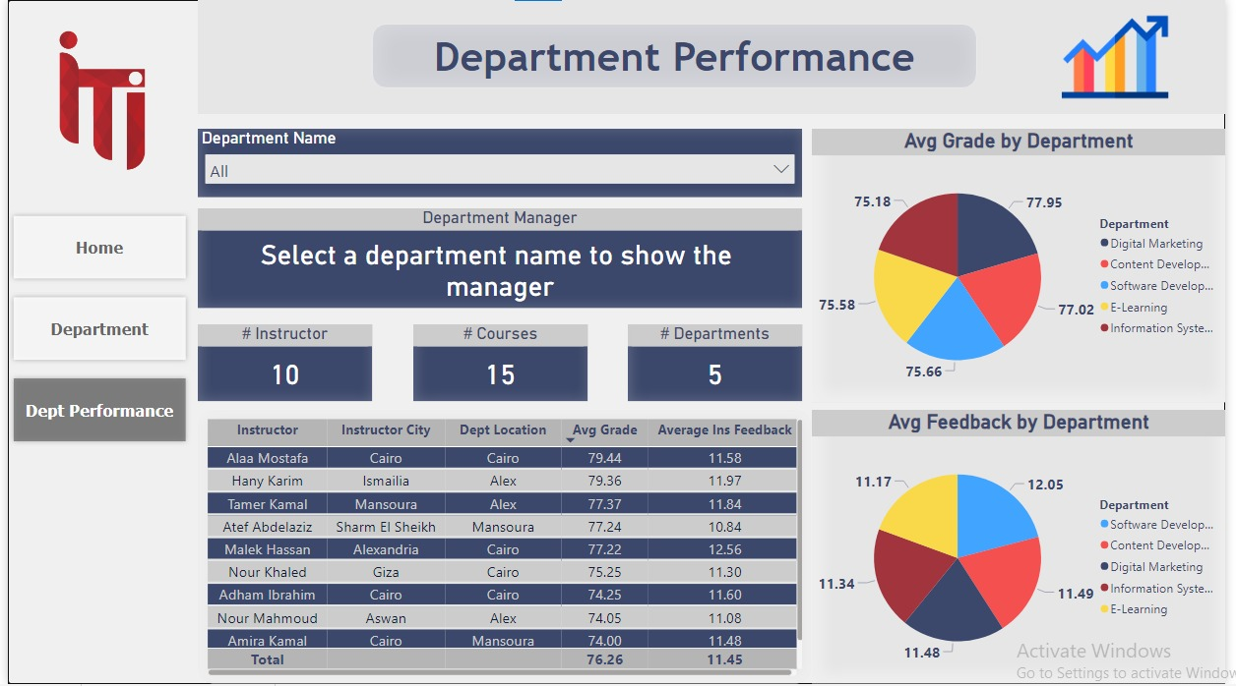
Dashboard

Slide 29
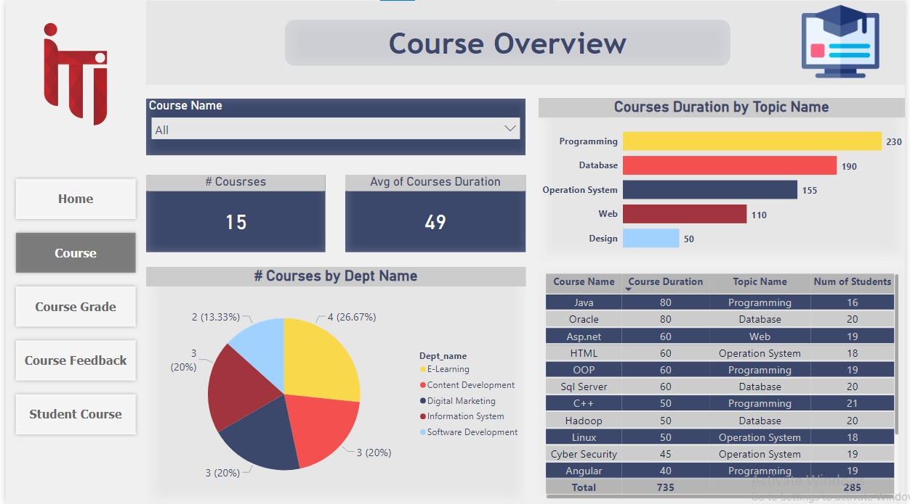
Dashboard

Slide 30
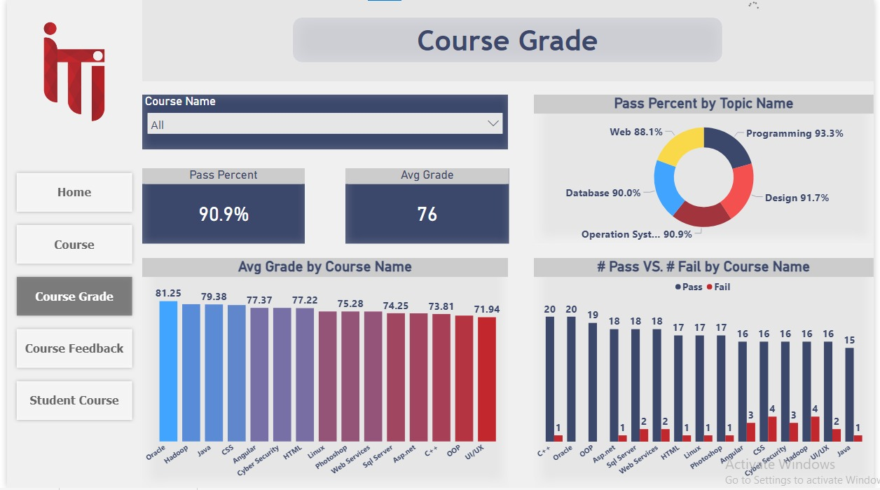
Dashboard

Slide 31
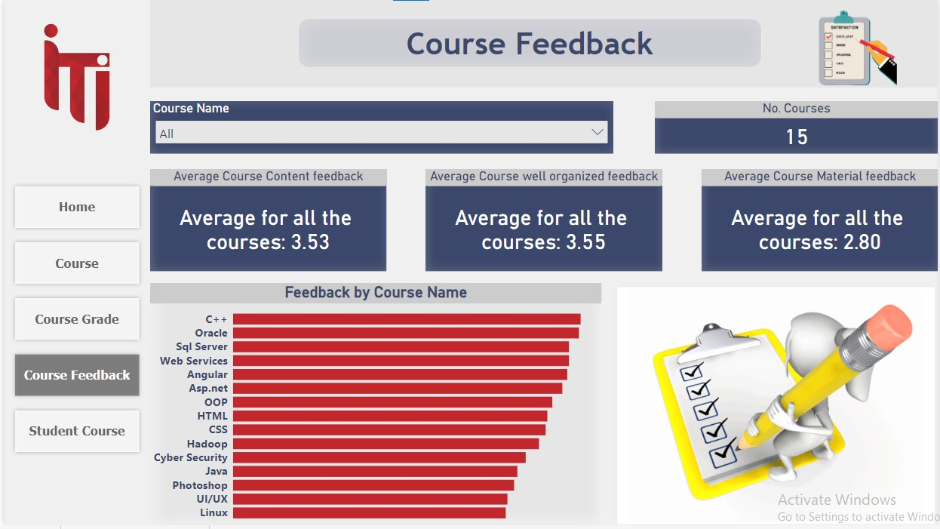
Dashboard

Slide 32
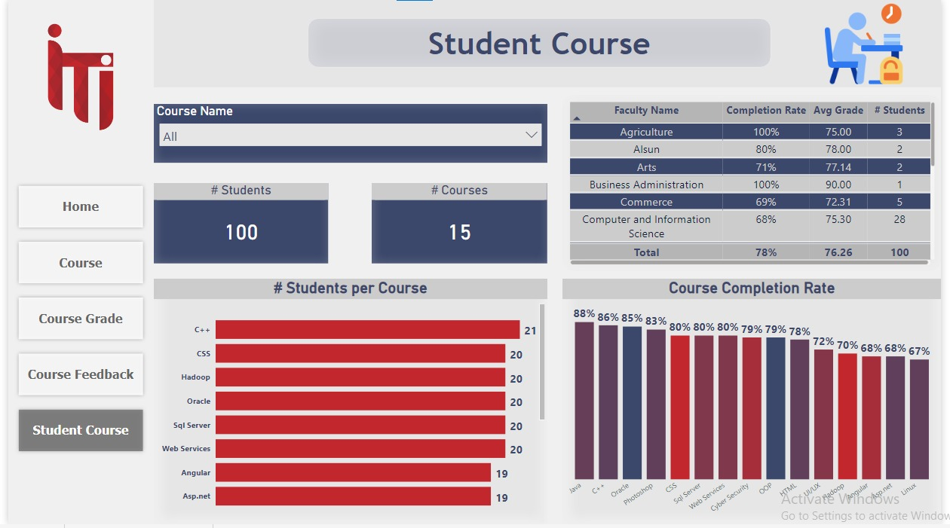
Dashboard

Slide 33
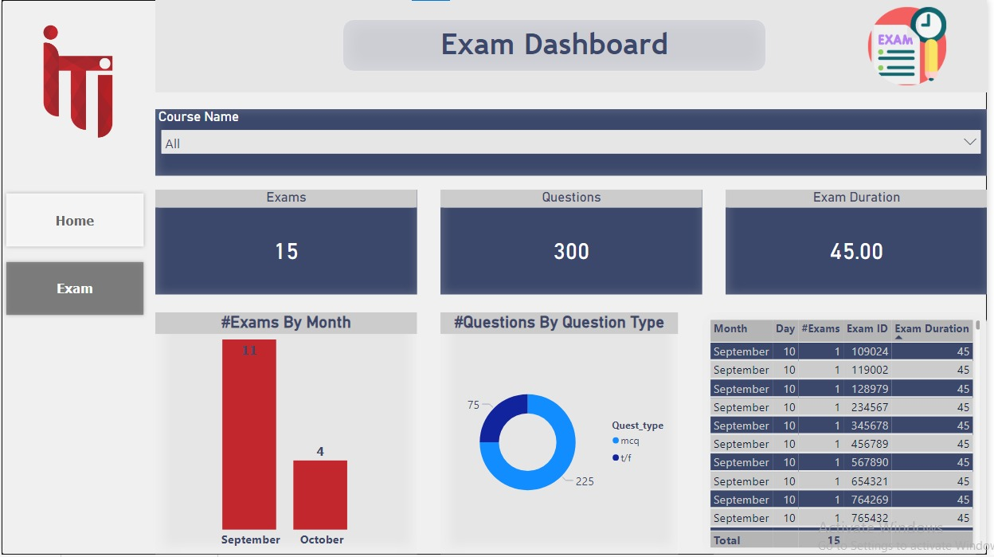
Dashboard

Slide 34

Website

Slide 35
Website

Slide 36
Website

Slide 37
Website

Slide 38
Website

Slide 39


